Slide 1

Flows by Example
Aric Levin
Lead Software Architect
Technical Project Manager

Slide 2

Introduction to Microsoft Flow

Slide 3

Microsoft Flow helps non-developers work smarter by automating workflows across apps and services
Get notifications
Copy files
Collect data
Automate approvals

Slide 4
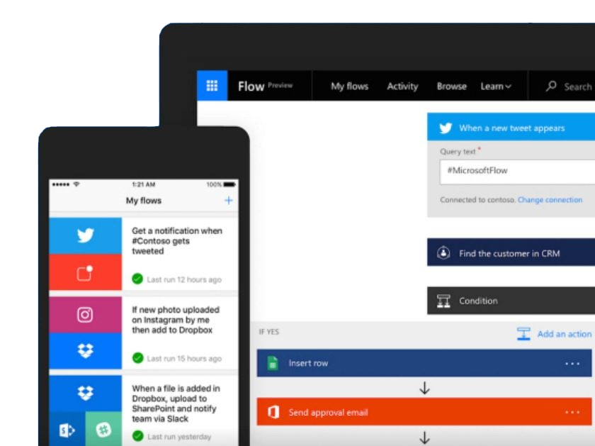
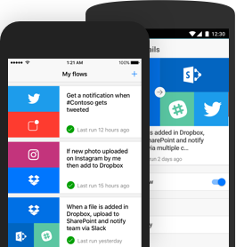
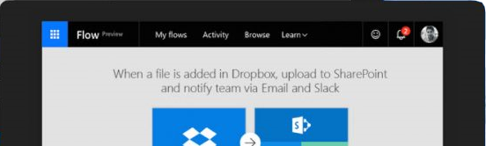
Work less, do more
Microsoft Flow helps people and teams work smarter by automating processes across their apps and data

Slide 5
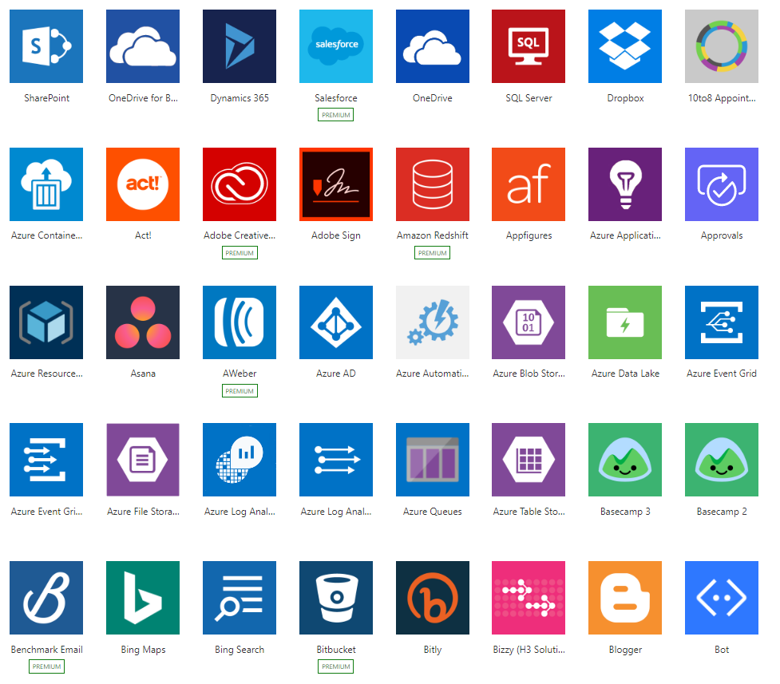
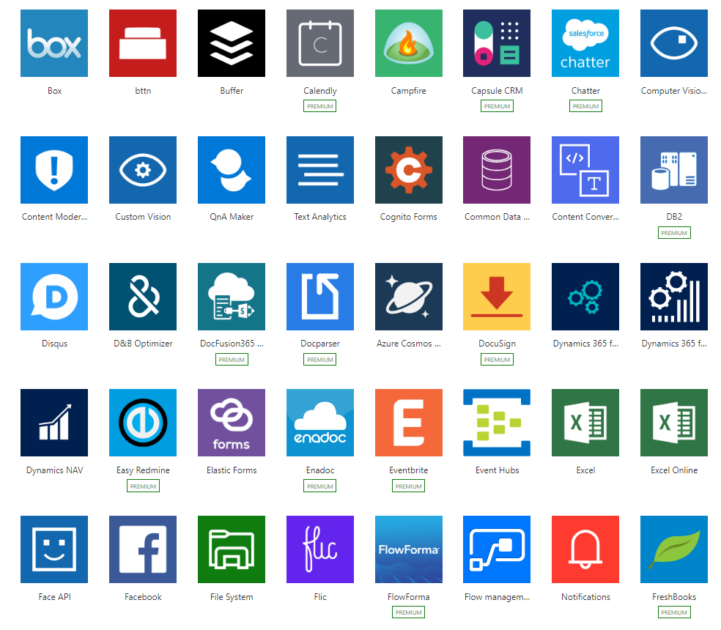
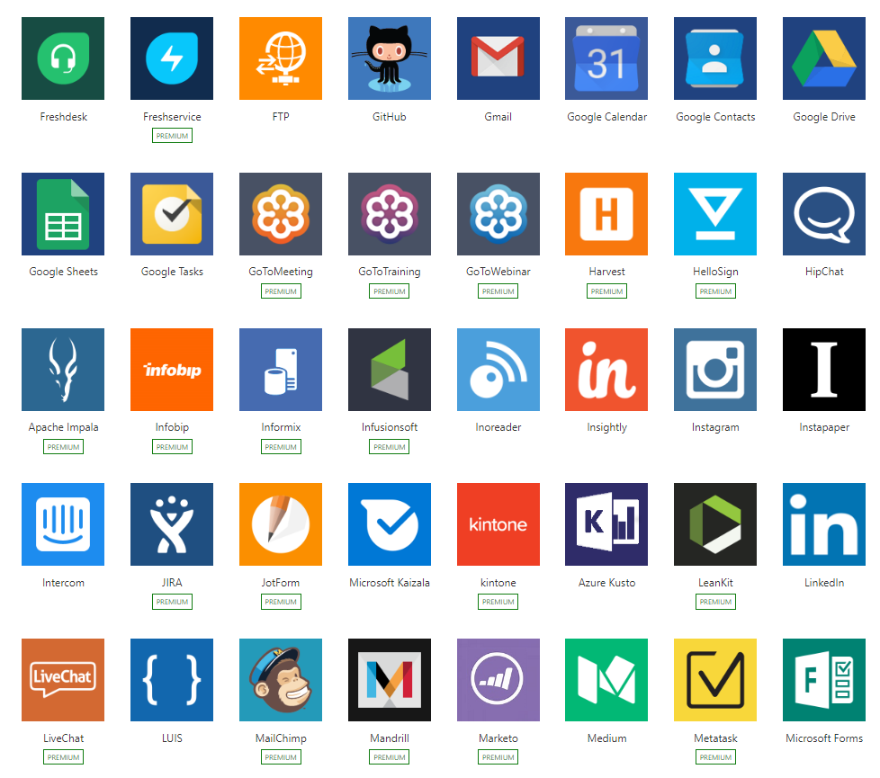
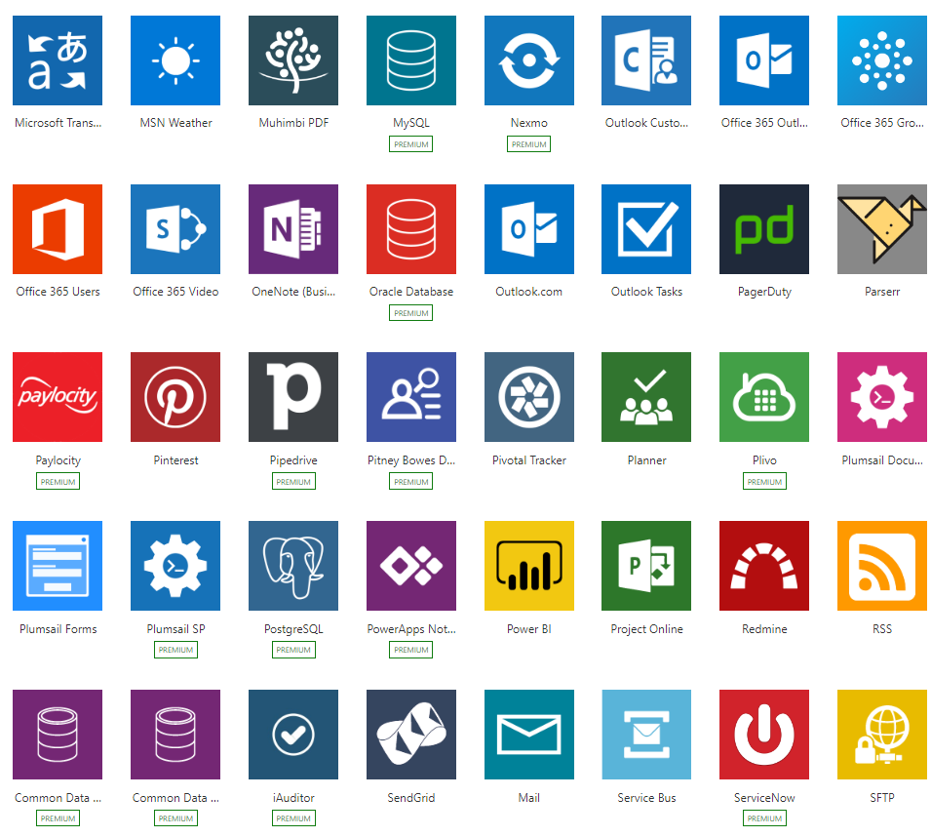
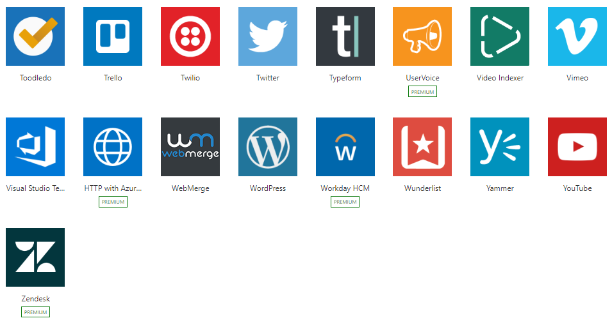
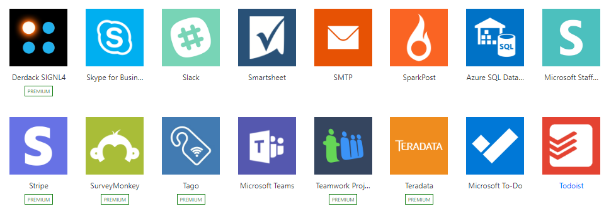
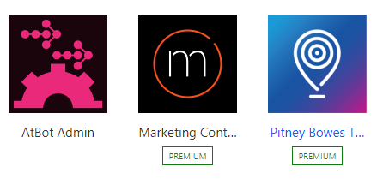
Integration + Connectivity
Built-in connectivity to 195+ SaaS cloud services, file providers, databases, web APIs, productivity apps, and more
Connect to on-premises systems via Data Gateway
Pluggable extensibility via Custom Connectors to integrate existing LOB systems into Flow

Slide 6
Building Flows

Slide 7

Components of flows
Starts with an event or trigger
Performs any number of actions
Can have conditional logic
Can trigger other workflows

Slide 8
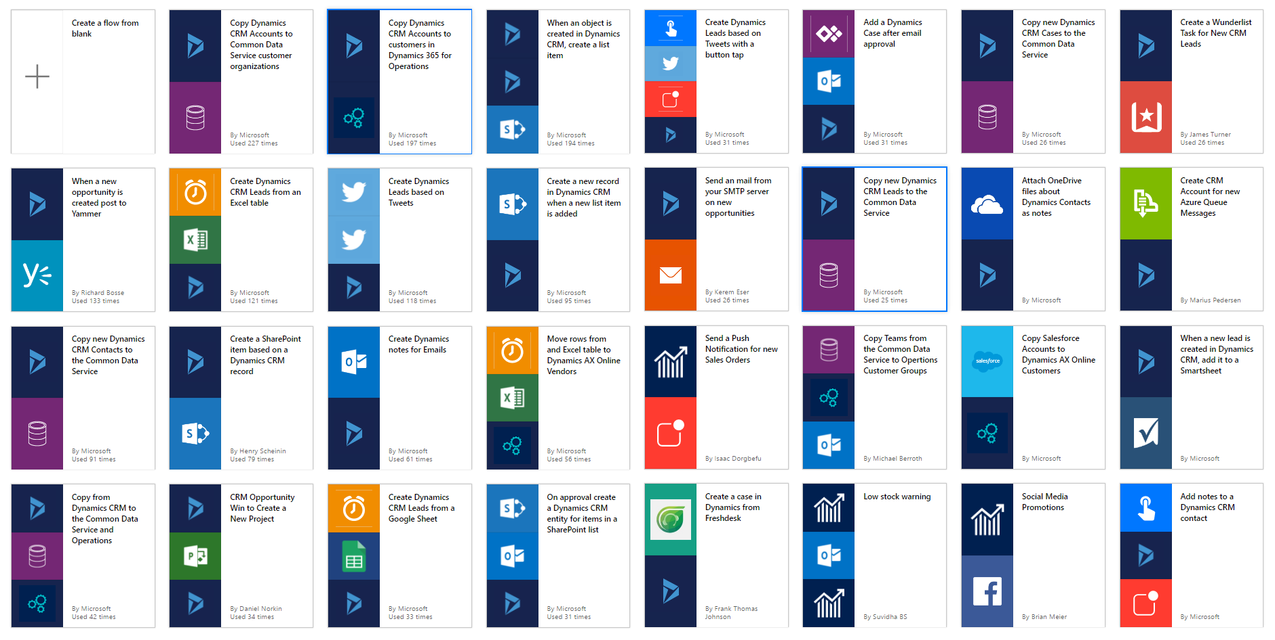
Templates help users to get started

Slide 9
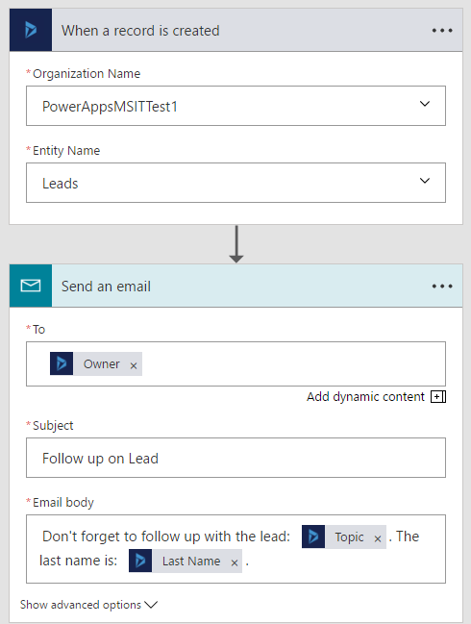
What makes up a flow?
Example: Notification Flow on Dynamics 365
Trigger – the event that kicks off the flow
In this example When a record is created
Actions – what the flow does
Send an email

Slide 10
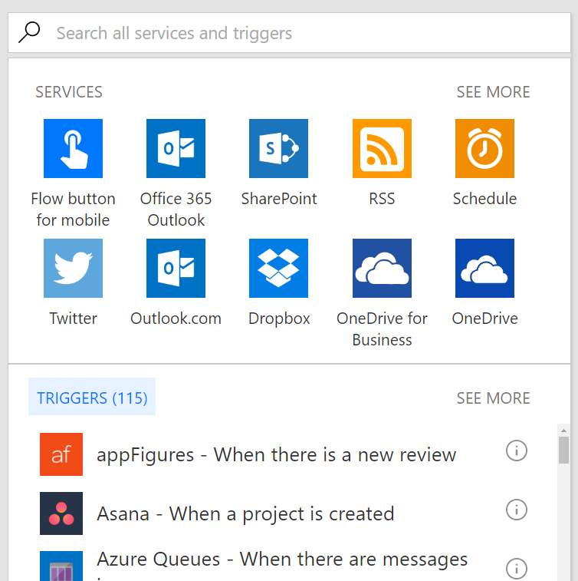
Triggers
Run manually based on user action
From dedicated Flow button
From other apps – PowerApps, SharePoint…
Run on a schedule
From every minute to 4am on Saturdays
Run based on an event that happens in a cloud or on-premises service

Slide 11
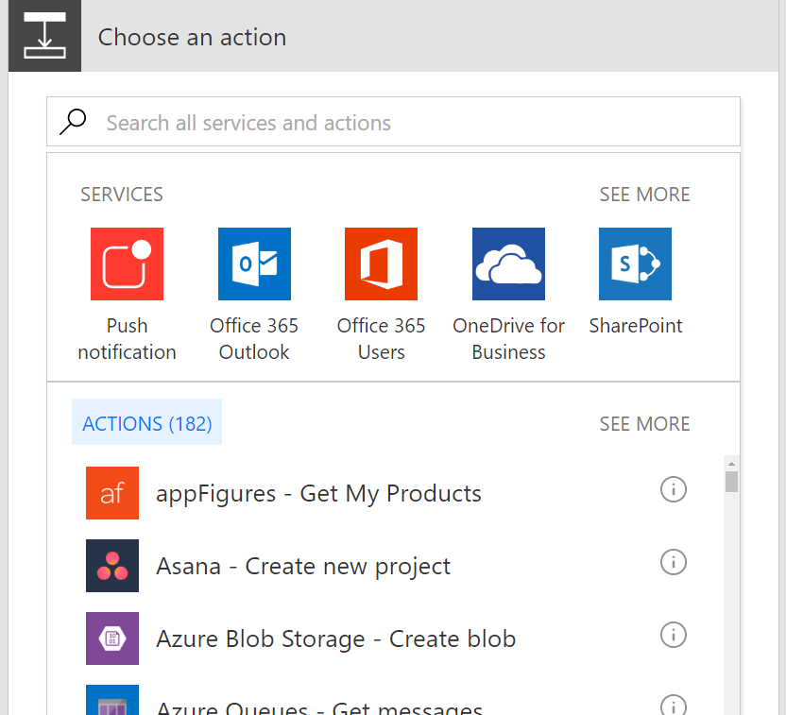
Actions
Any number of steps that run after the trigger
Connect to any cloud service or via the on-prem data gateway
Connect to any HTTP endpoints if there’s no out-of-box connector
Some actions may not even use connections – just manipulate data locally

Slide 12
Flowing data
Trigger
Outputs:
File name
Size
File content
Data ‘flows’ from each step and is available for all later steps
Use Add Dynamic Content to select outputs from previous steps
Certain outputs show up based on the types of the inputs and outputs
Action 1
A binary field would see:
File name
Size
File content
Outputs:
Title
Count
Action 2
A string field would see:
A number field would only see:
File name
Size
File content
Count
Title
Size
Count

Slide 13

Examples

Slide 14
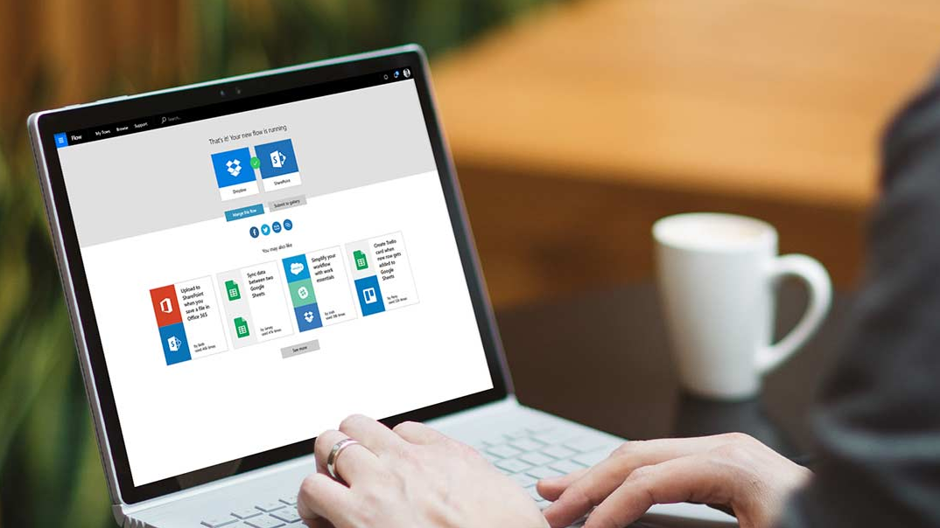
Demonstration
Service Request

Slide 15
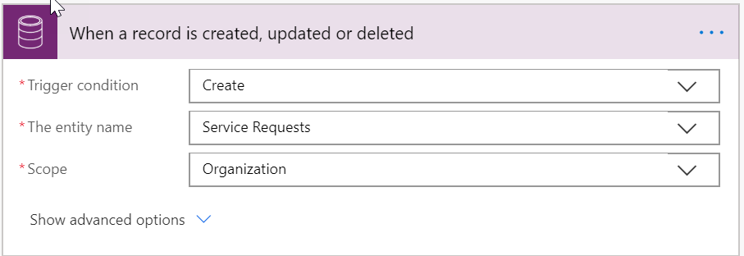
Service Request
Trigger when a new Service Request is created

Slide 16
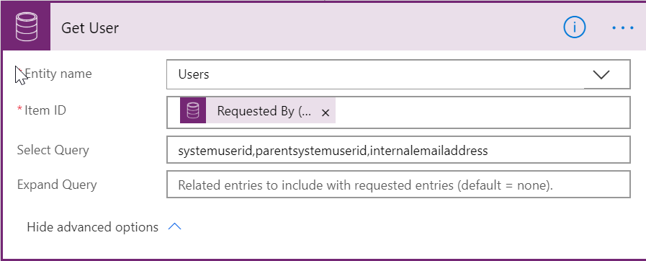
Service Request
Retrieve the user info of the submitter

Slide 17
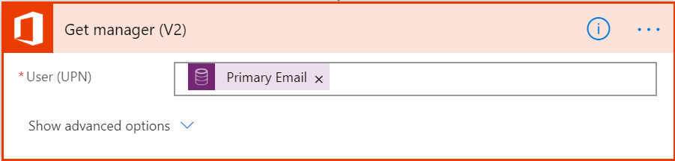
Service Request
Retrieve the manager info from Office 365

Slide 18
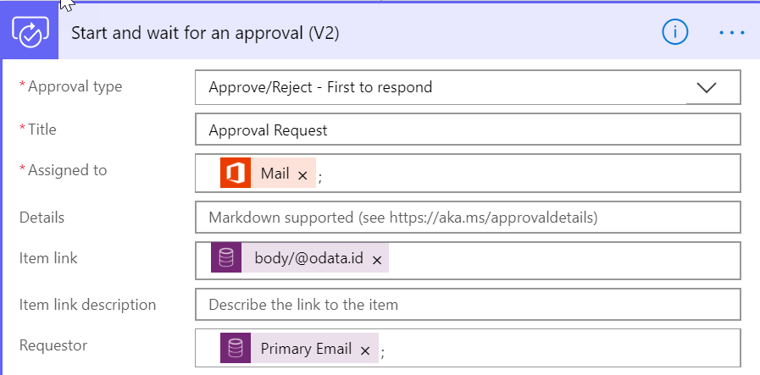
Service Request
Start the approval process and wait for Approval

Slide 19
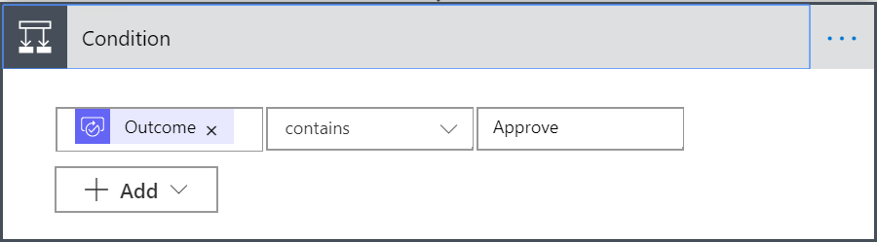
Service Request
Check the results of the Approval

Slide 20
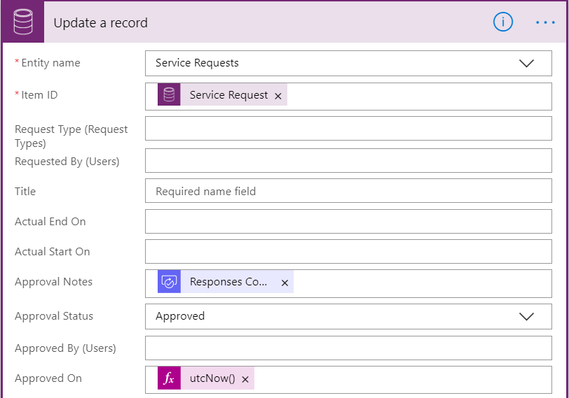
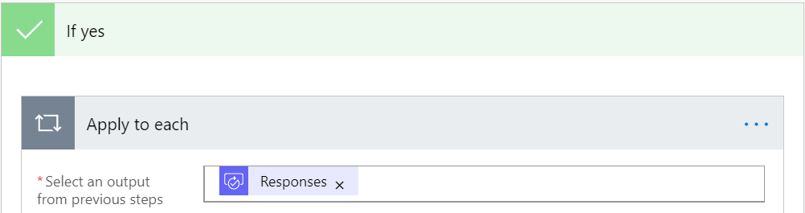
Service Request
Perform your Approval

Slide 21
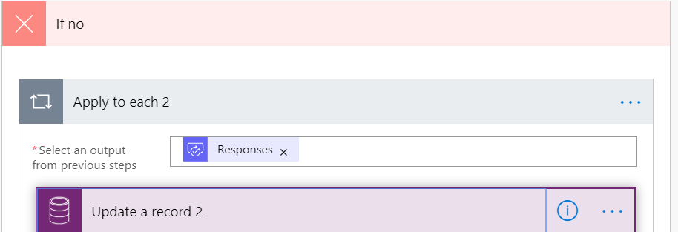
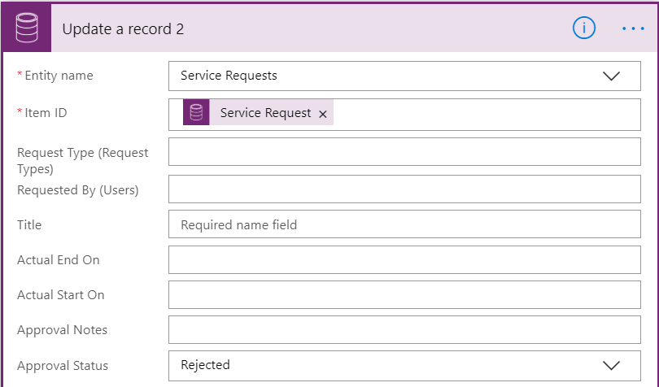
Service Request
Perform your Rejection

Slide 22
Demonstration
Document
Generation
Notes:
Demonstrate the labs before the hands on starts

Slide 23
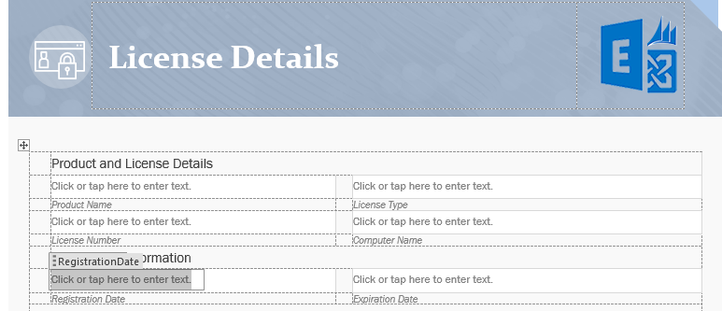
Document Generation
Create the document template

Slide 24
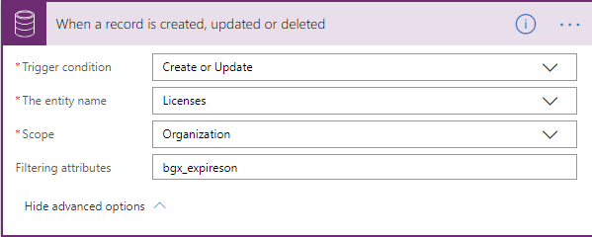
Document Generation
Add a trigger to your flow

Slide 25
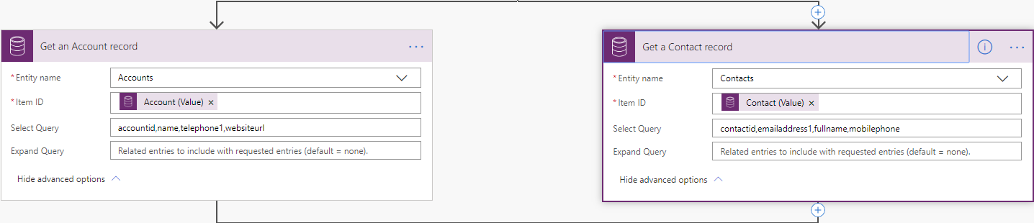
Document Generation
Get simultaneous data from entities

Slide 26
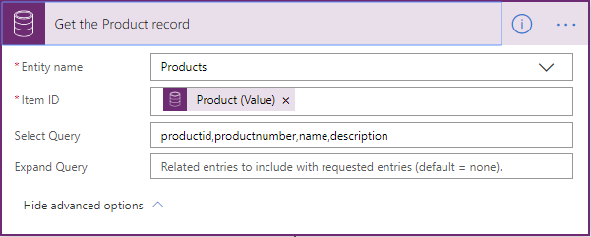
Document Generation
Get your product data

Slide 27
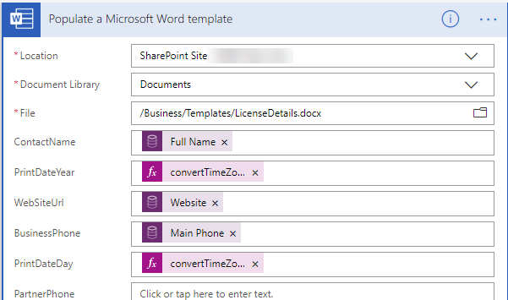
Document Generation
Populate the data in your word template

Slide 28
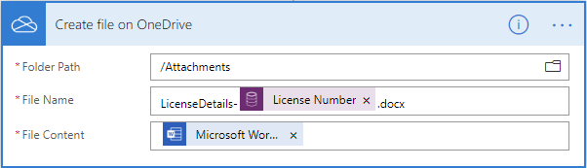
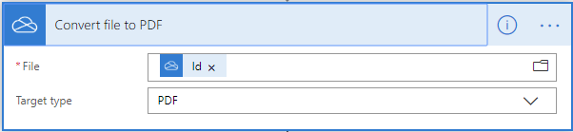
Document Generation
Create the file and convert to pdf (using OneDrive)

Slide 29
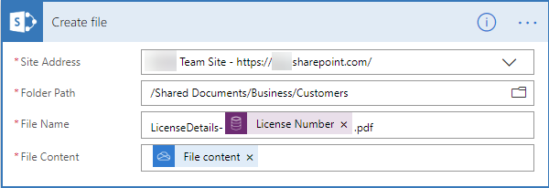
Document Generation
Save the file back to SharePoint

Slide 30
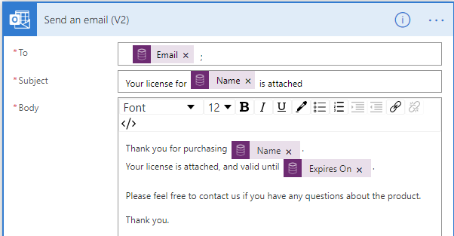
Document Generation
Send the file in email

Slide 31
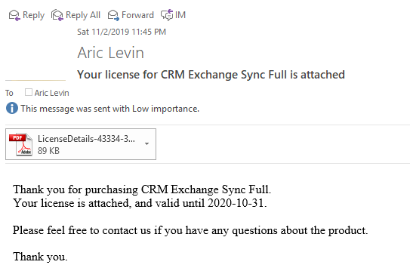
Document Generation
Receive the license in an email

Slide 32
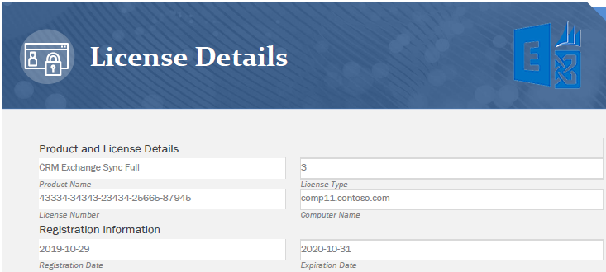
Document Generation
View the attached license

Slide 33

Debugging and Errors

Slide 34
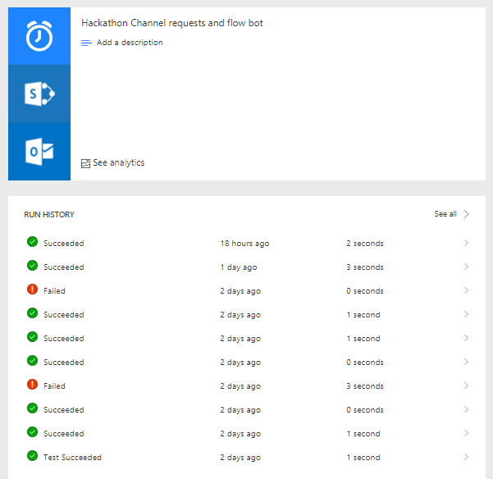
Debugging : check previous runs (run History)

Slide 35
Debugging : check errors in flow runs

Slide 36
Debugging : check previous runs

Slide 37
Debugging : live

Slide 38
Debugging : use the Test button
For testing a flow, use the Test button

Slide 39

Questions

Slide 40




www.ariclevin.com
www.youtube.com/channel/UCzdg6V5kkjiBufYnvJT4XWQ
github.com/ariclevin
www.linkedin.com/in/ariclevin

Slide 41




Business Applications
Communities
Connect · Learn · Share · Inspire
Join the Microsoft Business Applications Communities where you can connect with peers and experts and earn recognition for your contribution. Get answers to complex questions, learn from engaging discussions, read informative blogs, view webinars, and find product use examples in galleries.
https://community.dynamics.com
https://community.powerbi.com
https://community.powerapps.com
https://community.flow.microsoft.com

